Slide 1






Multi-State Optical Memory Integration on Silicon Photonics Waveguides Using High-Index Resistive Memory
Student: Pin Zhi Chen
Advisor: Ricky W. Chuang
Notes:
本研究將記憶體元件與類神經網路結合，透過量測 ReRAM（新興記憶體）元件的數據來訓練機器學習模型。
我們希望藉此評估不同元件的壽命及製程條件對學習率與性能的影響。

Slide 2
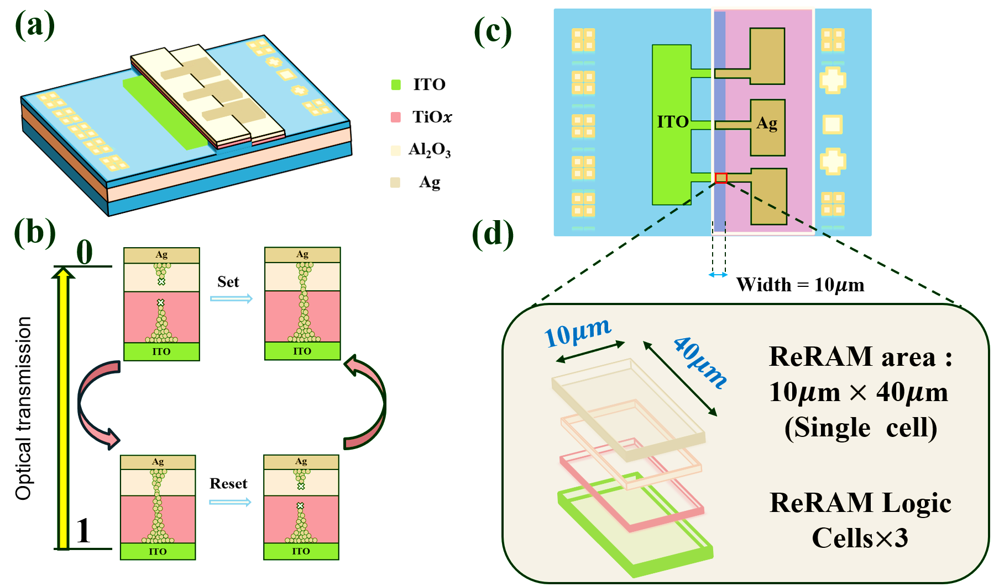


Introduction
ReRAM-integrated optical memory with filament-based modulation mechanism.

Slide 3
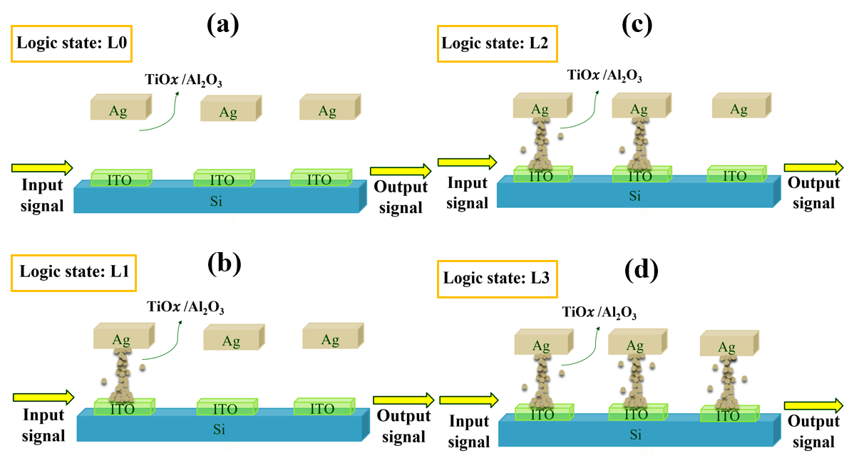
The optical readout under different logic states

Slide 4
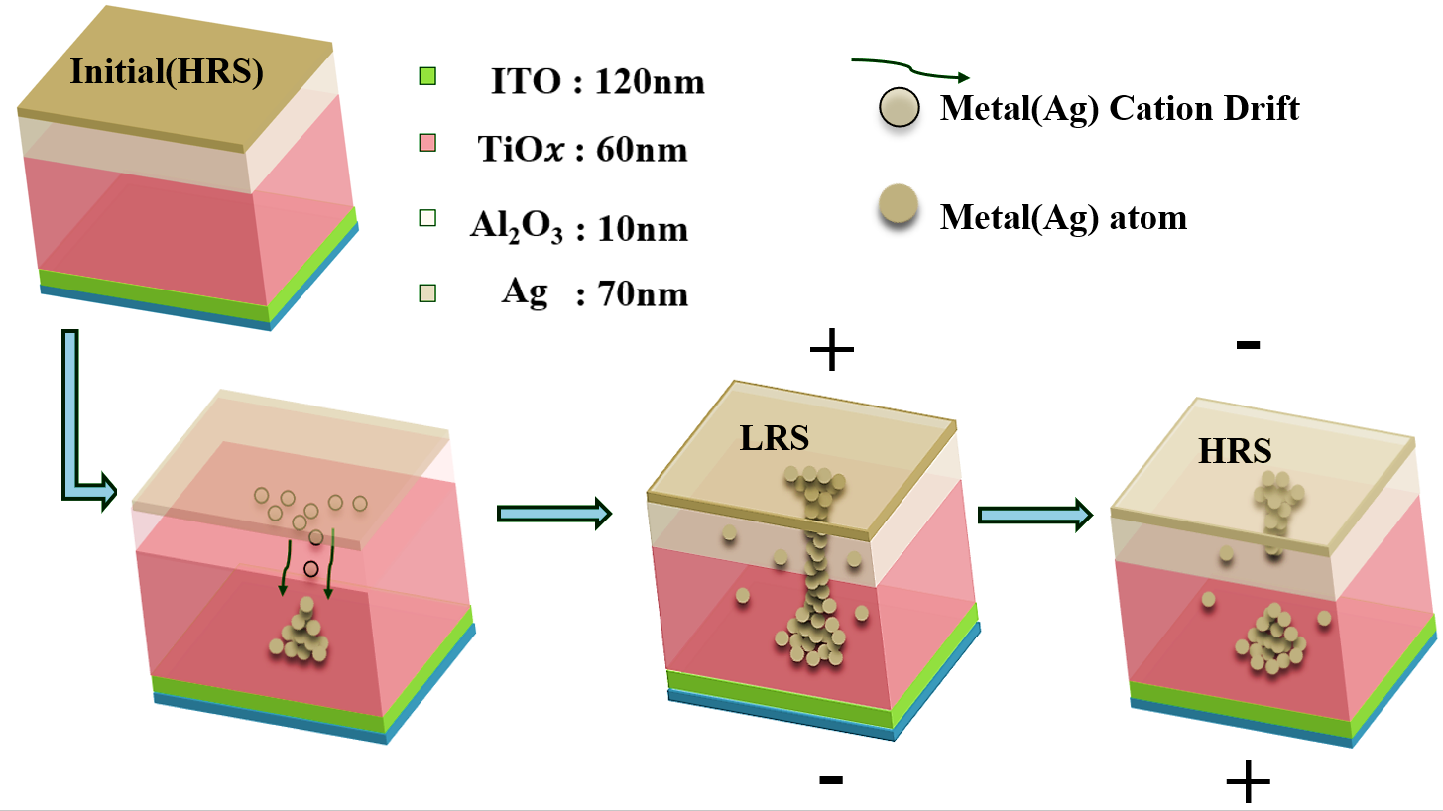
Operating principle of optical memory using ReRAM as a modulation element.

Slide 5

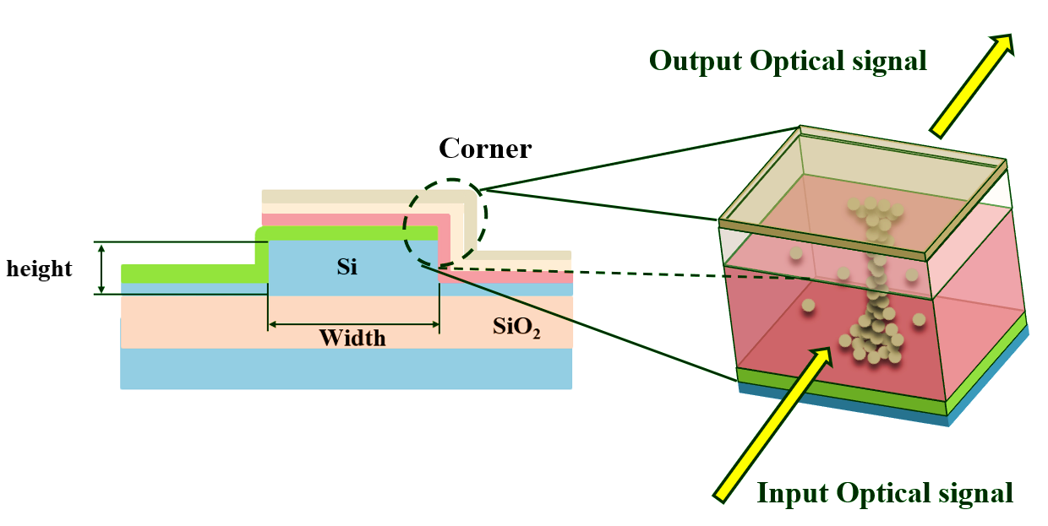

EFS
Enhance electromagnetic field confinement
Reduces operating voltages($V_{forming}$ 、$V_{set }$ 、 $V_{reset }$)

Slide 6
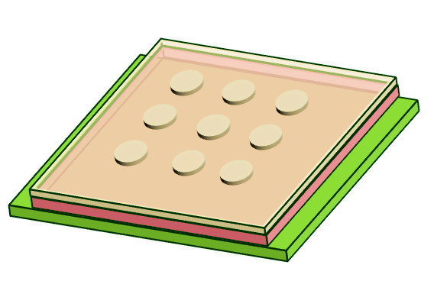
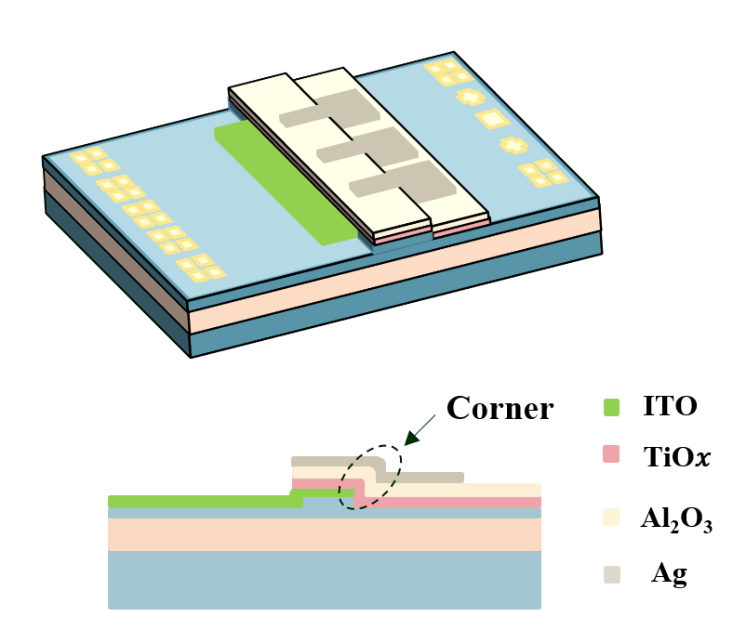
Elevated-Film-Stack (EFS)
Planar structure
Elevated-Film-Stack (EFS)

Slide 7
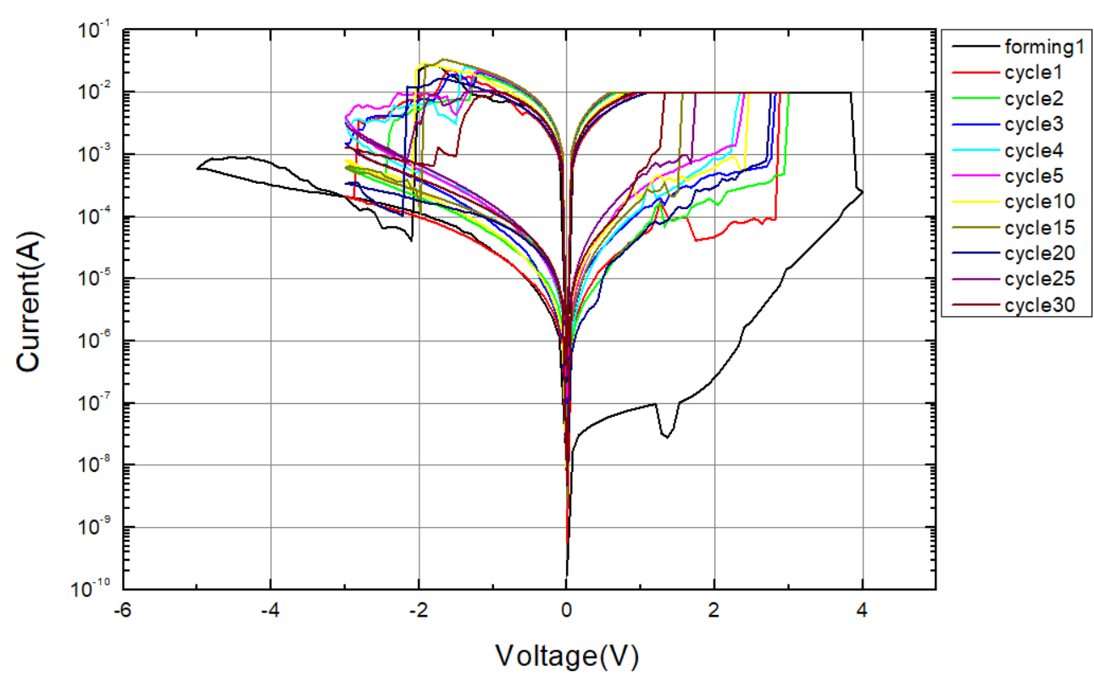
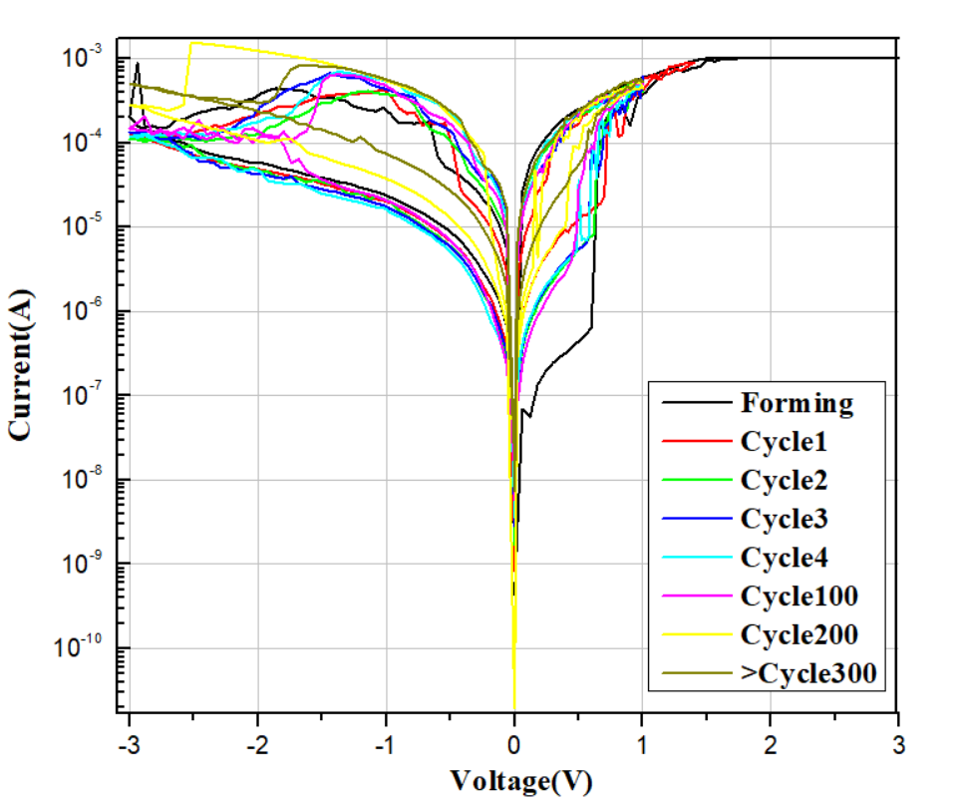
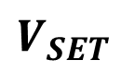
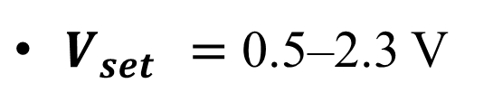
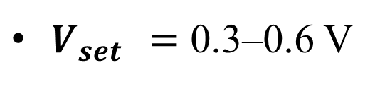
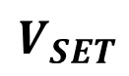
Planar structure
Elevated-Film-Stack (EFS)
$$V_{SET}$$
$$V_{SET}$$
$V_{set }=$ 0.5–2.3 V
$V_{set }=$ 0.3–0.6 V

Slide 8
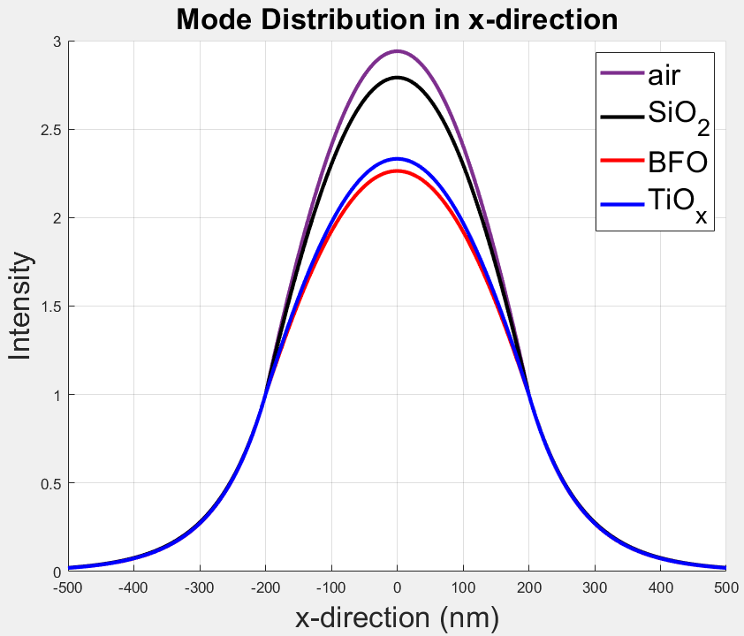
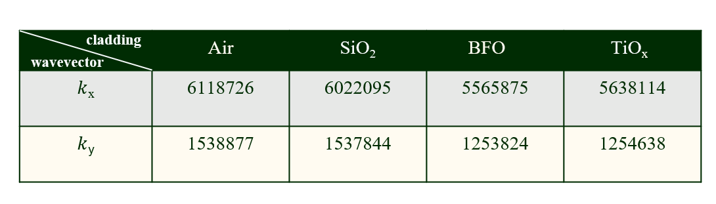
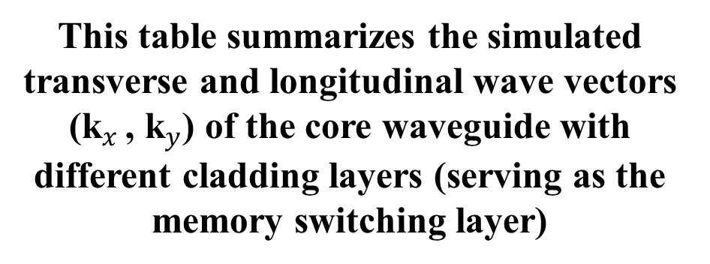
Simulation
This table summarizes the simulated transverse and longitudinal wave vectors (k$​_{x }$, k$​_{y}$) of the core waveguide with different cladding layers (serving as the memory switching layer)
The light field intensity distribution in the x direction of the waveguides with different cladding layers.

Slide 9
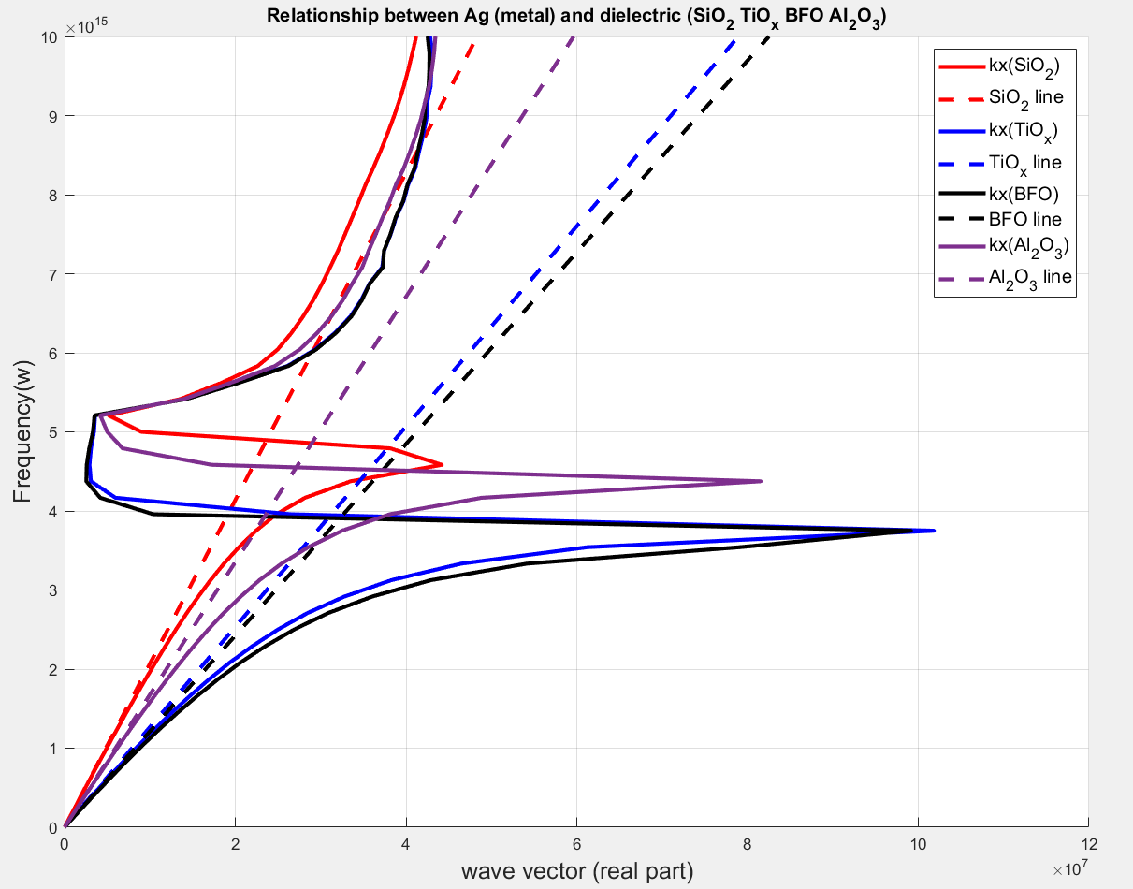
SPP dispersion characteristics and material influence

Slide 10
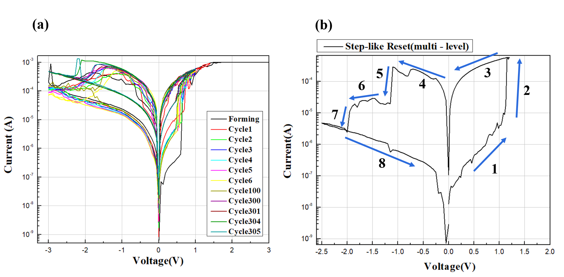
RESULTS AND DISCUSSION
I-V Curve
(Endurance cycling of ReRAM)

Slide 11
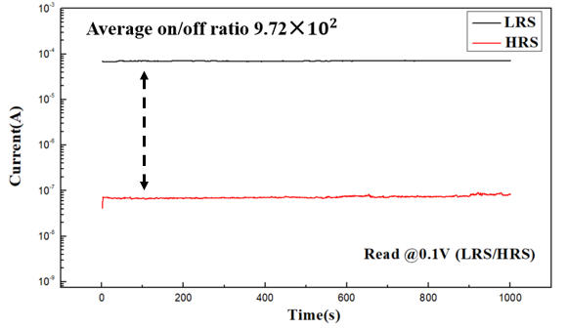
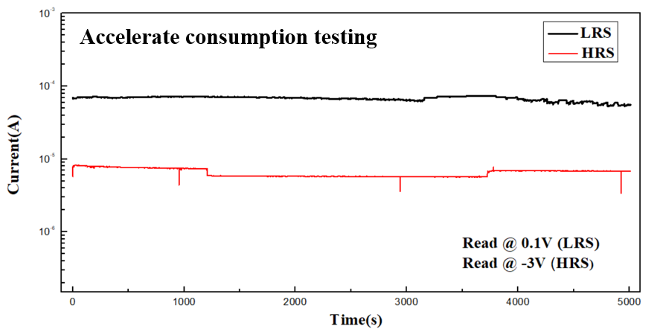
Retention time test / Accelerated life testing

Slide 12
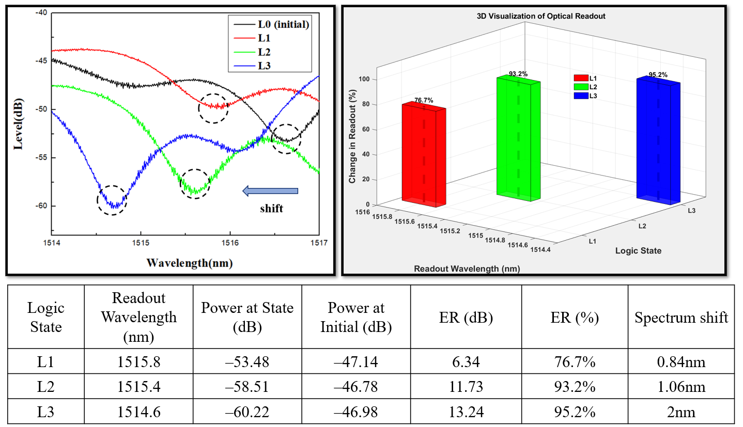
Multi-level (Spectrum)

Slide 13
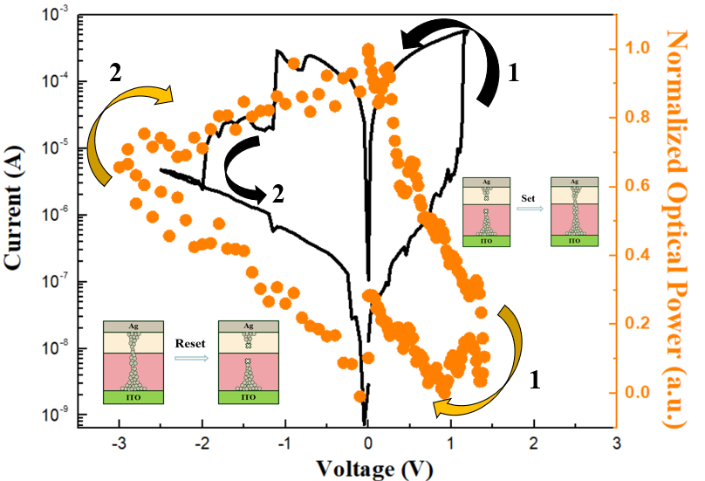
Electro-optical synchronized measurement
The electro-optical synchronized measurement shows that when the voltage is switched off, the optical power does not return to its original value but instead exhibits a clear hysteresis phenomenon

Slide 14
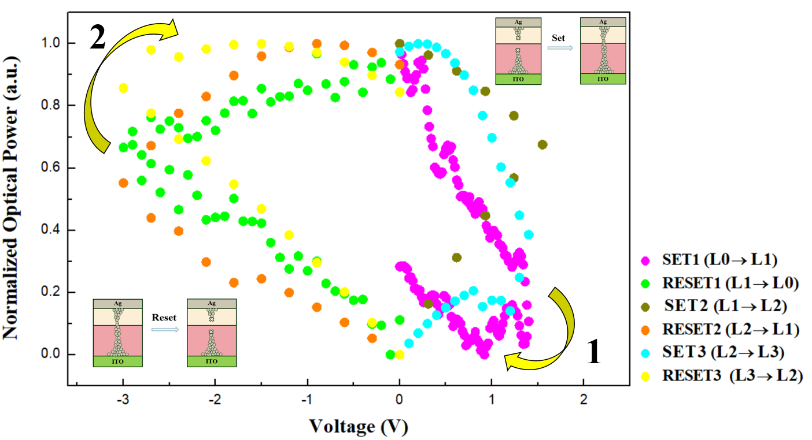
Optical hysteresis curves for three programmed memory states (L1, L2, and L3).

Slide 15
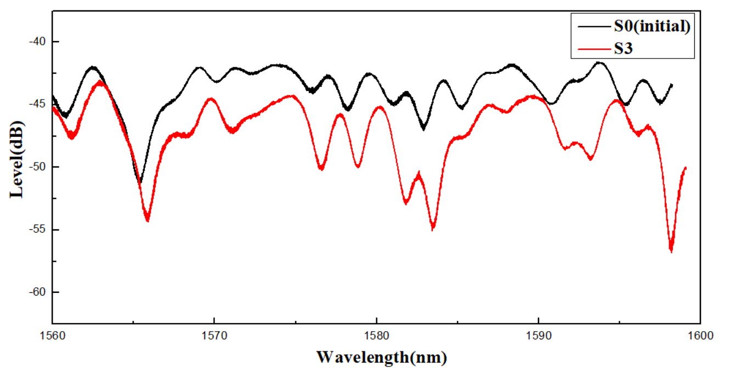
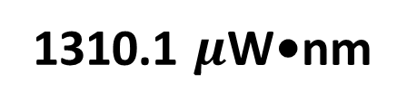
Spectral energy comparison (S0) vs (S3)
1310.1 $μ$W•nm

Slide 16
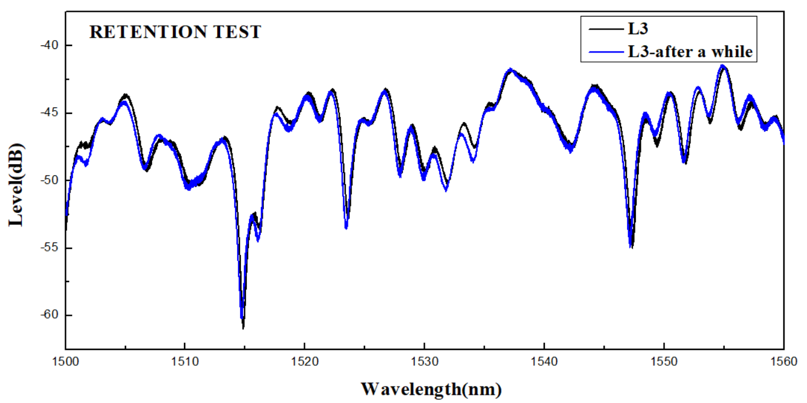
The retention test was conducted by monitoring the optical spectrum.

Slide 17
Conclusion
Successfully demonstrated a non-volatile, multi-level optical memory by integrating ReRAM (BiFeO₃, TiO𝑥, Al₂O₃) onto a silicon photonic waveguide.
The elevated film stack (EFS) enhanced filament–light interaction and enabled low-voltage, low-power operation.
Spectral measurements revealed stepwise extinction ratios of 6.34 dB (L1), 11.73 dB (L2), and 13.24 dB (L3), along with a total spectral shift of 2 nm and a reduction in integrated spectral energy by 1.31 mW•nm in the L3 state, confirming broadband optical response and strong filament–light interaction.
Memory states remained optically distinguishable at 0 V, confirming true non-volatility.
Electro-optical tests at 1550 nm showed normalized transmission increasing from ~0.72 (L1) to >0.8 (L2, L3).

Slide 18

Supplementary Information
Notes:
本研究將記憶體元件與類神經網路結合，透過量測 ReRAM（新興記憶體）元件的數據來訓練機器學習模型。
我們希望藉此評估不同元件的壽命及製程條件對學習率與性能的影響。

Slide 19
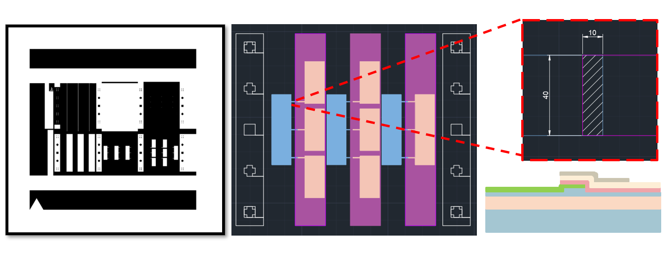
Mask Design

Slide 20
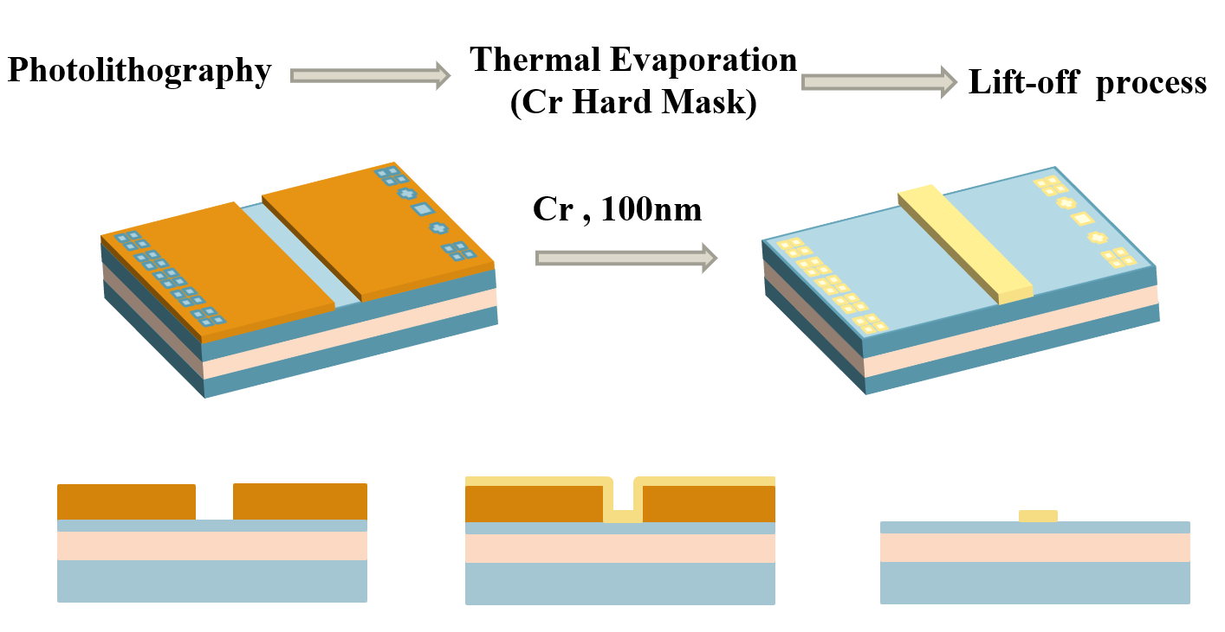
Waveguide fabrication

Slide 21
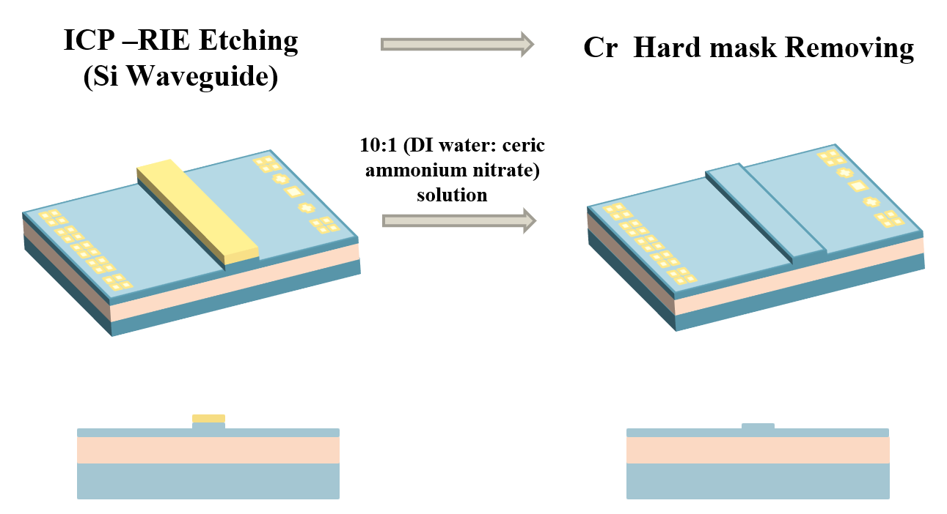

Slide 22
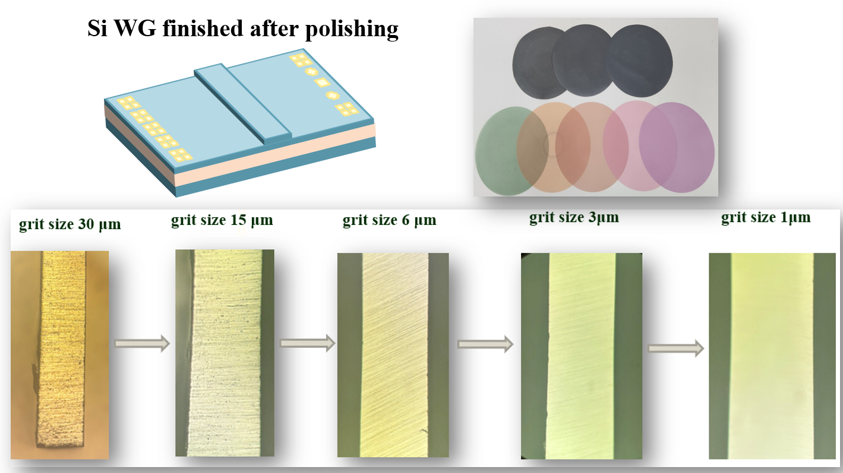

Slide 23
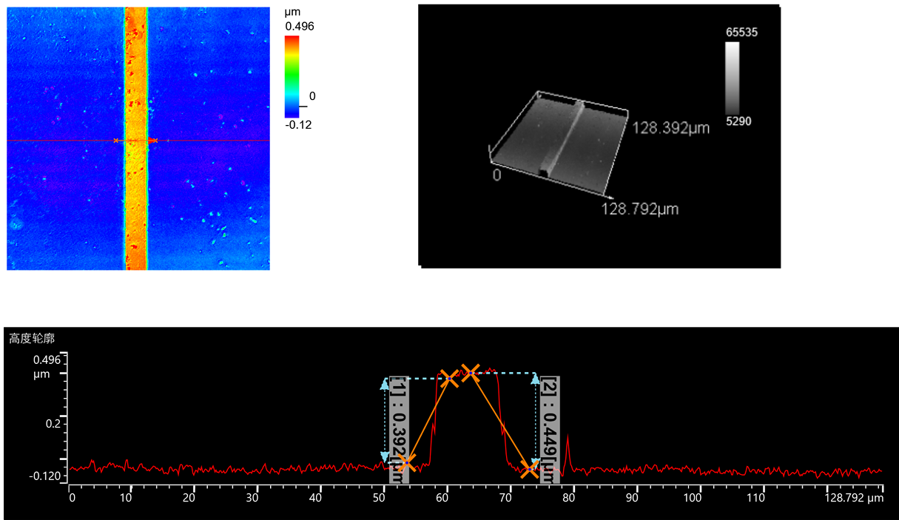
A 3D laser microscope

Slide 24
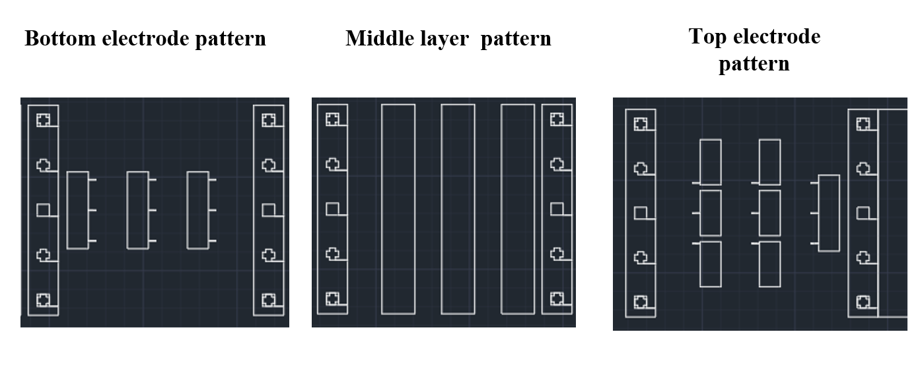
Mask Design(for ReRAM)

Slide 25
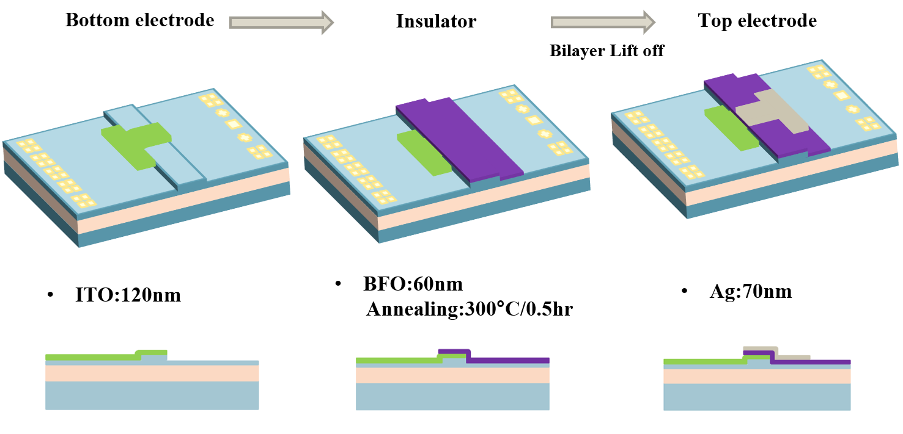
ReRAM fabrication-BFO

Slide 26
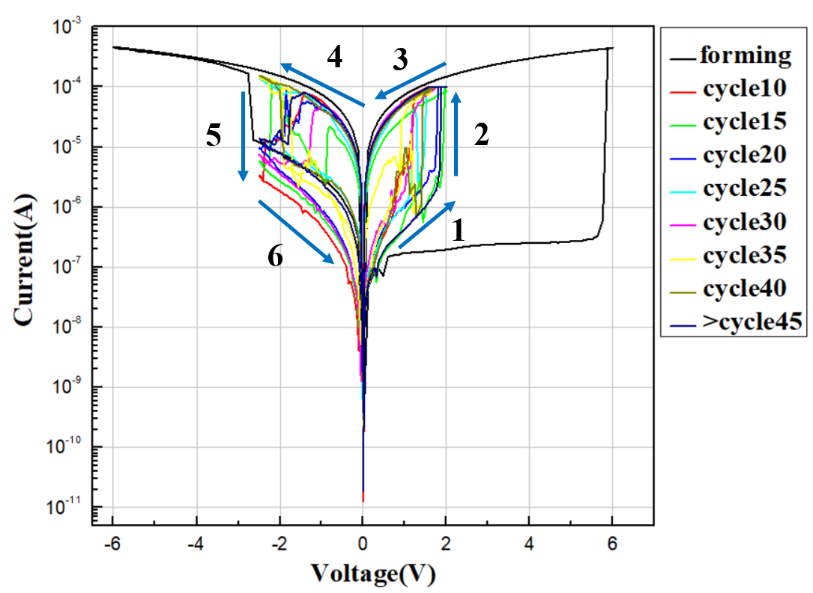
ReRAM IV curve-BFO

Slide 27
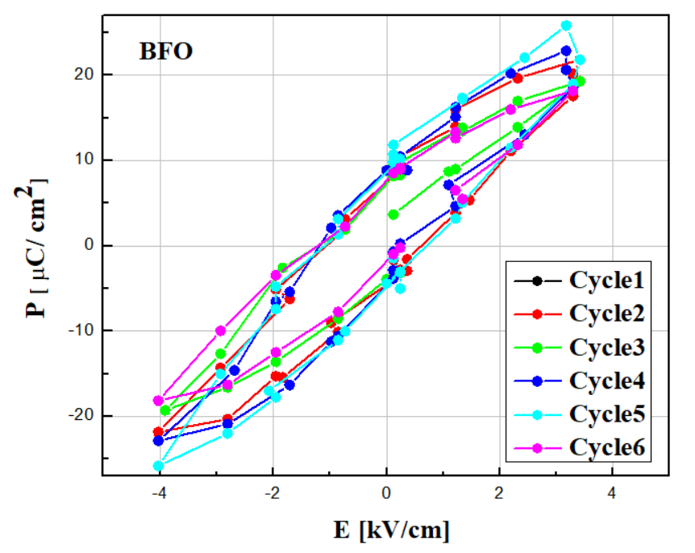
Ferroelectric Characterization of BiFeO₃ Thin Films

Slide 28
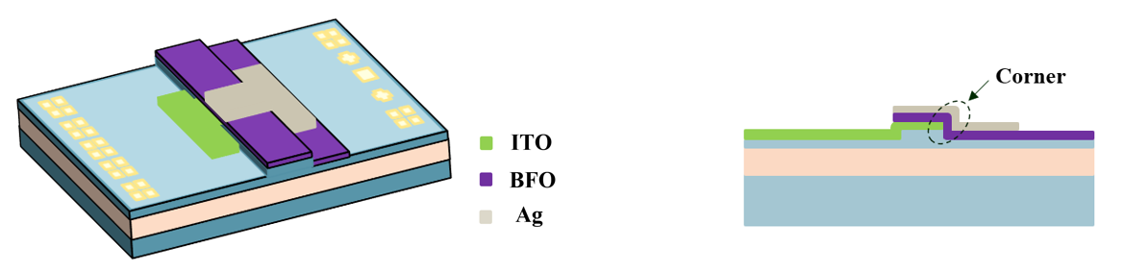
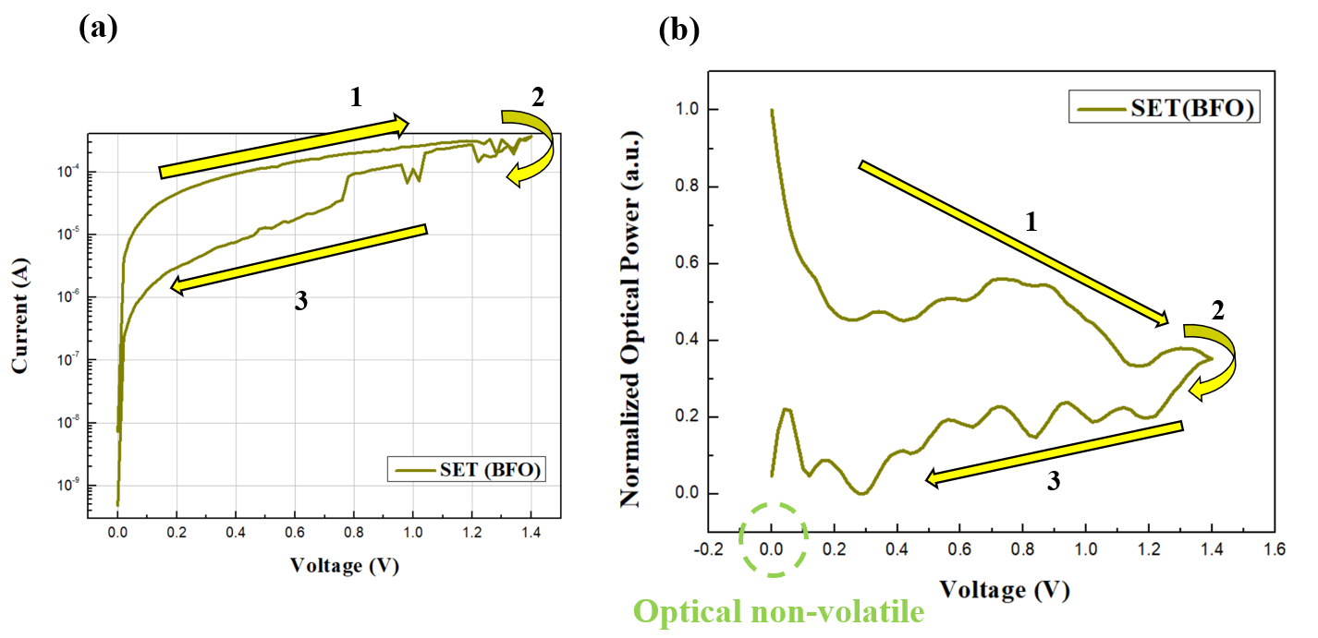
Optical Memristor measurement-BFO

Slide 29
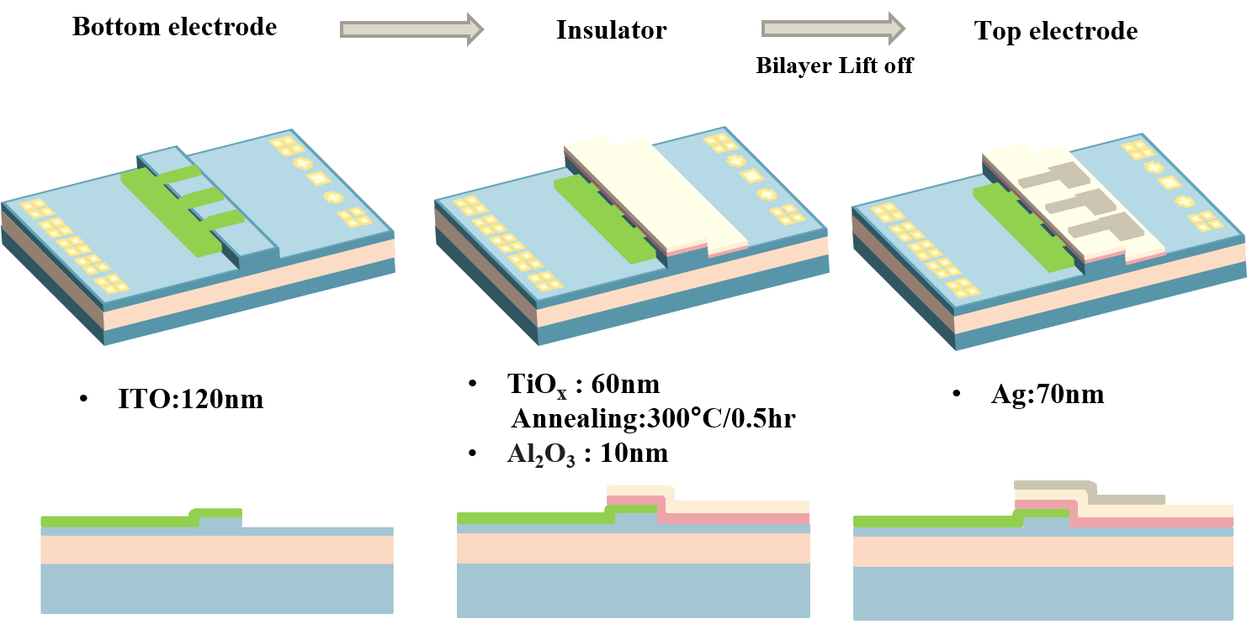
ReRAM fabrication- Al₂O₃ / TiO_{x}

Slide 30
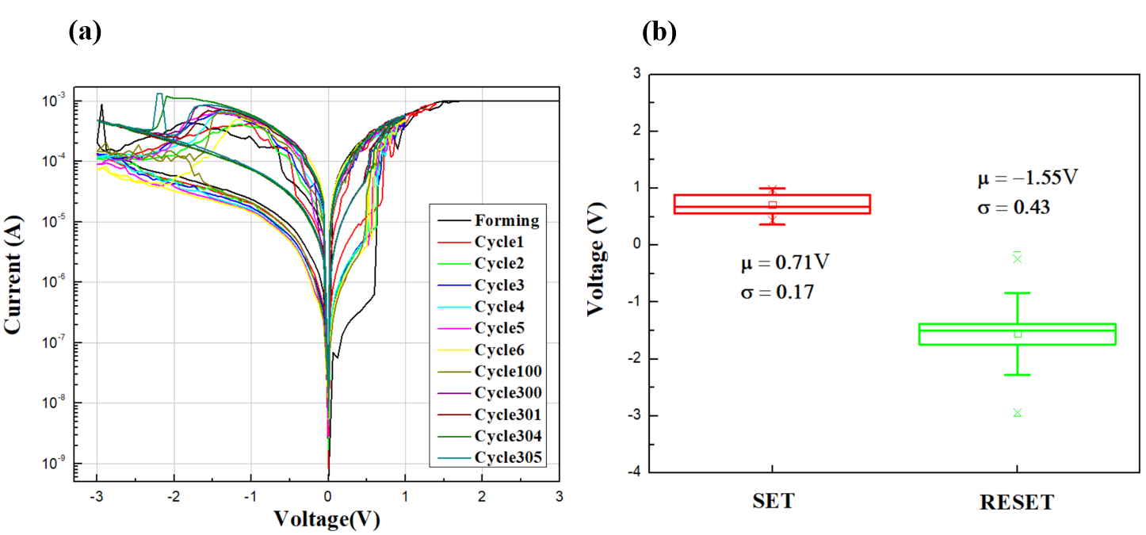
Box plots illustrate the variability in switching voltages

Slide 31
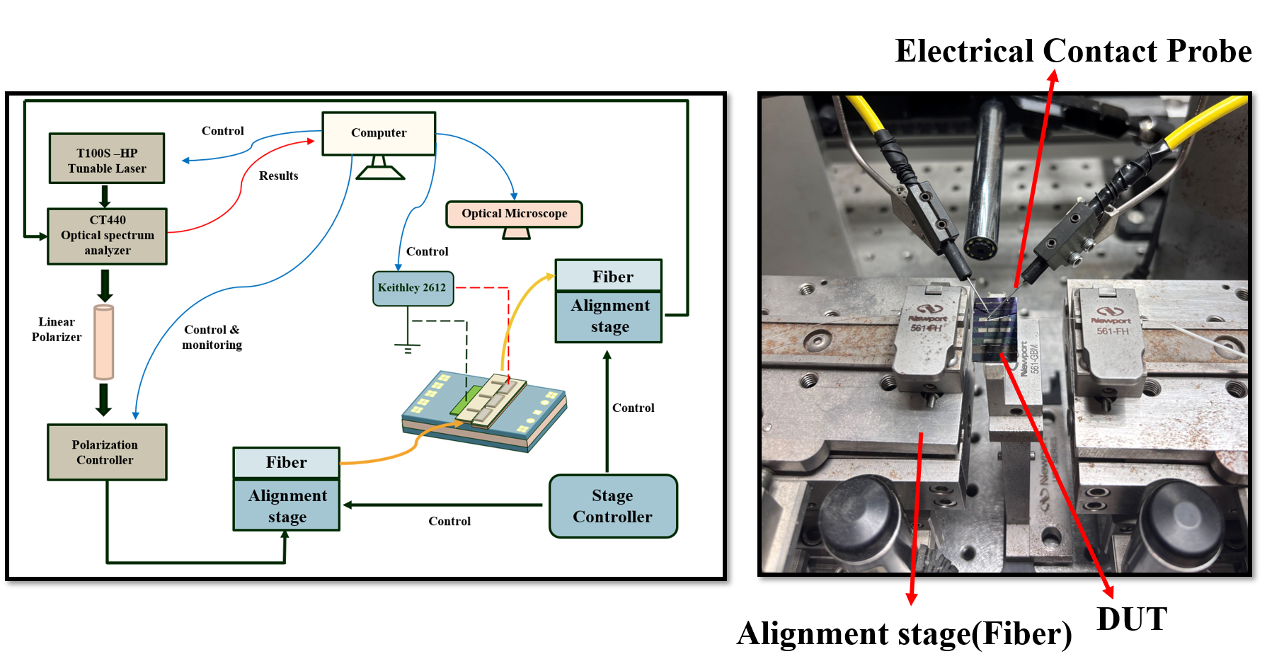
Optical Memristor measurement setup

